Slide 1

Facebook Mini Application
Presented By
Sai Praveena Lakshmi Pardesi
Anusha Gurrala
Tasneem Amina
Shravani Adyre
Shaik Basheer Ayesha Na

Slide 2
Introduction
Facebook mini application provides an interactive place for users to post articles, upload photos and search contents.
A new user can register in to our application by giving their information and he gets registered in to the system.
The registered users can login in to system by giving username/password.
The registered user will have a user profile and associated contents.

Slide 3
Facebook Mini Application
Facilitates users to search - user profiles such as name, gender, school, groups, categories and events.
The user can create an event, group and can become the owner/admin of the group.
He has the facility to join the group and subscribe to particular category based on his interests or likes.
Over all, the system stores information about user profiles, files, user’s likes, groups and its owner/members etc.

Slide 4
Implementation
Tools used :
Oracle SQL 11g
Netbeans IDE 8.2
Framework : Java Servlets
HTML, CSS
Glassfish Server

Slide 5
Entities
Users
Accounts
User Friends
Status
Relationship
Events
Category Likes
User Likes
Check Ins
Workplace
Groups
User Groups
Album
User Photos
User Videos

Slide 6
System Design
Relationships:
Users>Account(1-1)
Users>Friends(1-M)
Users>Status(1-M)
Users>Relationship(1-M)
Users>Events(M-M)
Category_Likes>User_Likes(M-M)
Users>Check_Ins(1-1)
Users>Workplace(1-M)
Users>Groups(M-M)
Groups>User_Groups(M-M)
Album>User_photos(M-M)
Album>User_Videos(M-M)
Composite Attribute: Name
Derived Attribute: Age

Slide 7
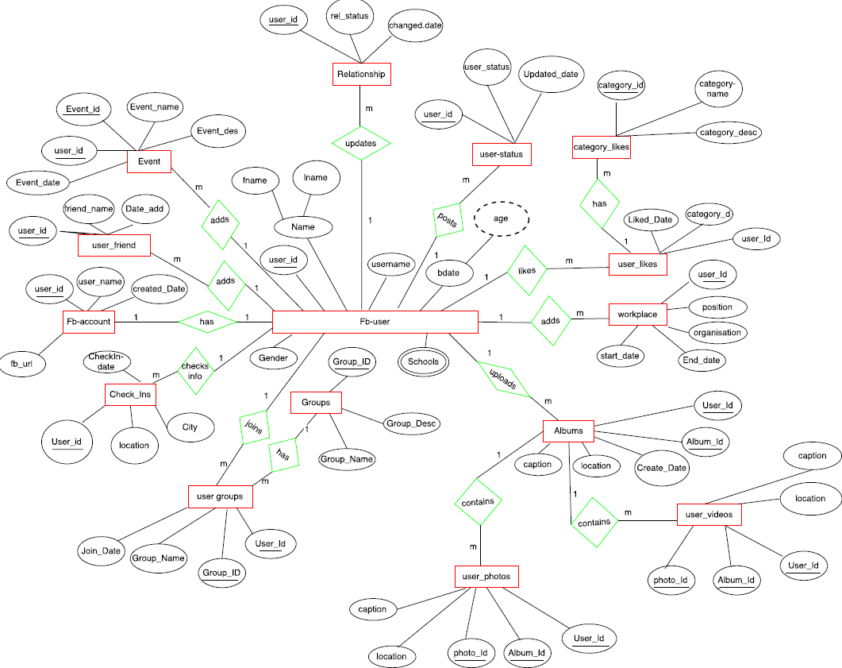
Conceptual Model : ER Diagram

Slide 8
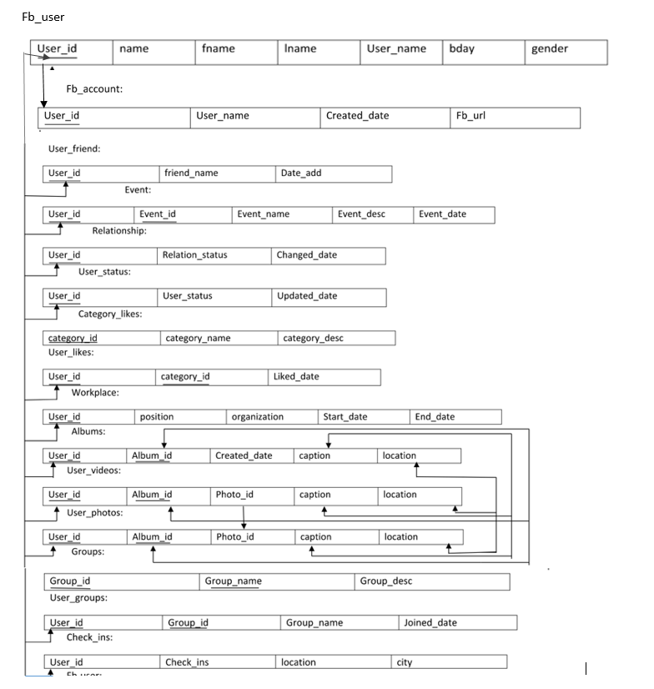
Database Schema

Slide 9
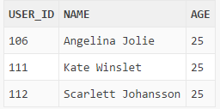
Queries
1) Display the female users who are between the age group 18 and 25.
SELECT user_id,fname||' '||Lname as Name,trunc((SYSDATE - BDATE)/365.25) as Age from fb_user where trunc((SYSDATE - BDATE)/365.25) >= 18 and trunc((SYSDATE - BDATE)/365.25)<=25 and Gender='F' ;

Slide 10
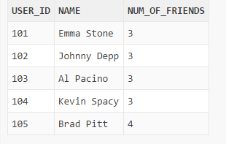
Queries
2) Display the users and count of their friend list from the Database
SELECT f.user_id,u.fname||' '||u.Lname as Name, Count(f.Friend_ID) as Num_of_Friends FROM user_friend f,fb_user u where u.user_id=f.user_id group by f.user_id,u.FNAME,u.lname;

Slide 11
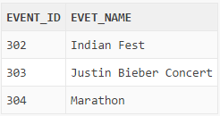
Queries
3) Display the events Emma Stone will be attending in the month
of April 2017
SELECT event_Id,evet_Name from Events where event_date>='01-Apr-2017' and event_date<='30-Apr-2017' and user_id=(select user_id from fb_user where fname='Emma' and lname='Stone');

Slide 12
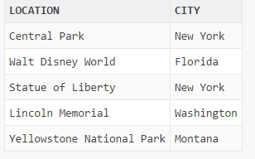
Queries
4) Display the most visited place along with the city (more than 3 visits)
SELECT Location, city from Check_ins group by Location, city having Count(Location) >3;

Slide 13
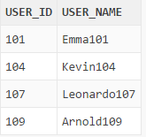
Queries
5) Display the usernames of users who are going to University of Dayton and who are in the groups 'University of Dayton' and 'Arts and Science';
SELECT user_name from fb_user where school_name like 'University of Dayton' and user_id in (select user_id from user_groups where group_name In ('University of Dayton','Arts and Science'));

Slide 14
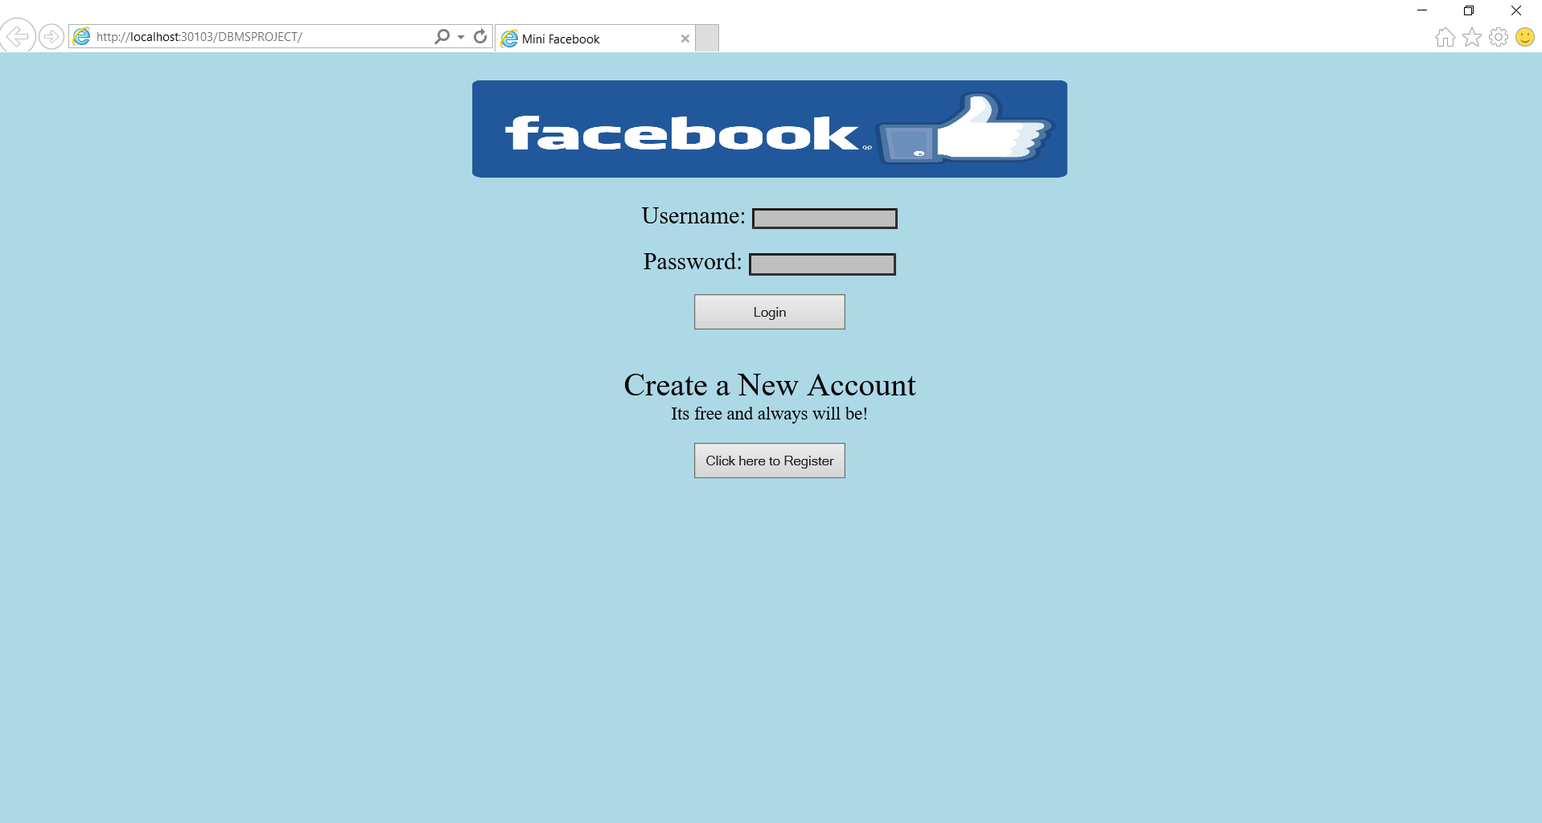
Implementation Screenshots
Login Page

Slide 15
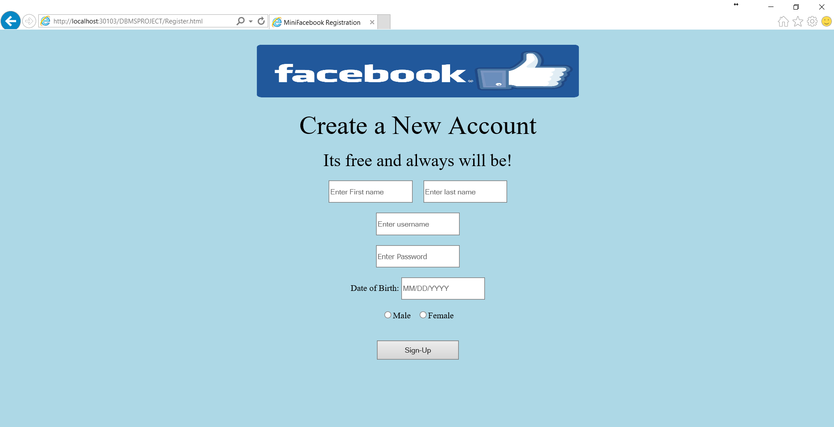
Implementation Screenshots
Registration Page

Slide 16
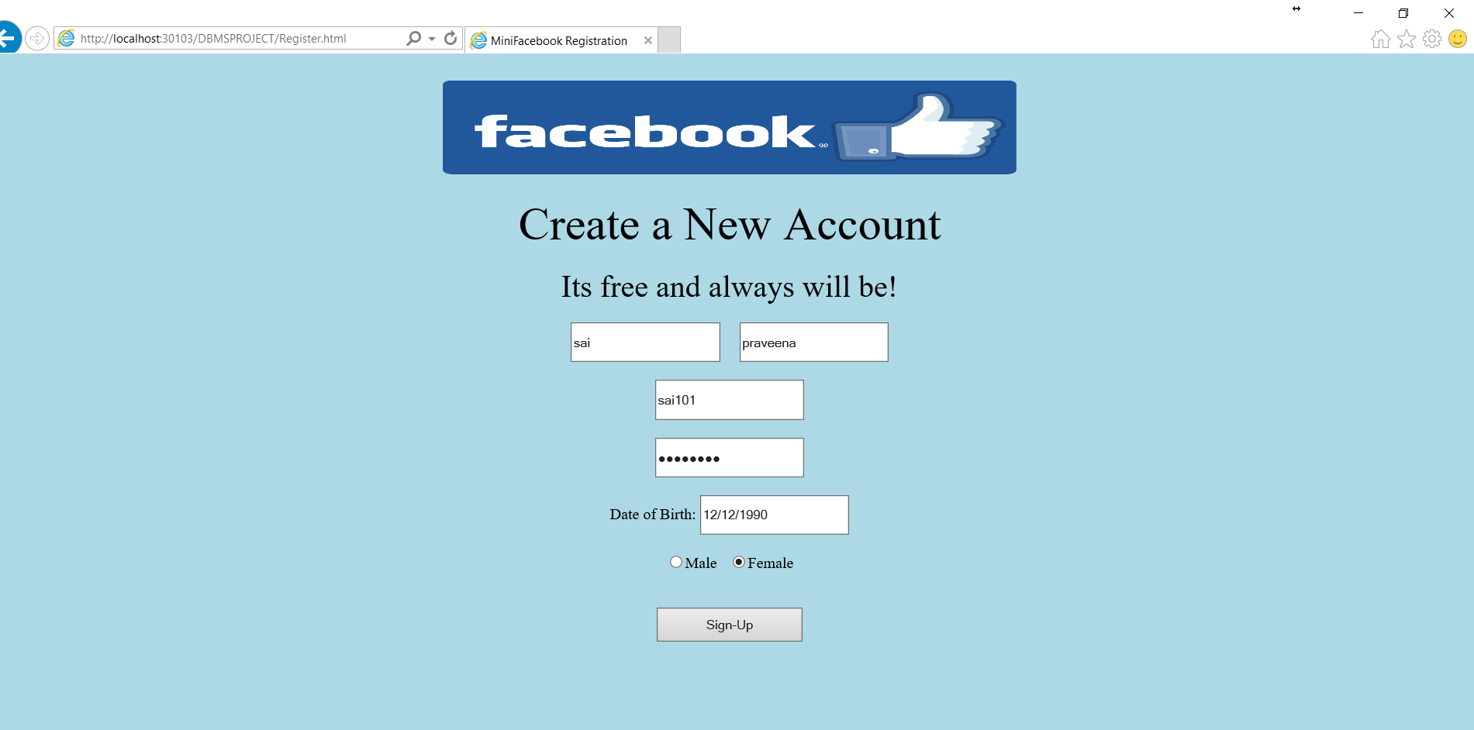
Implementation Screenshots
Registration Page

Slide 17
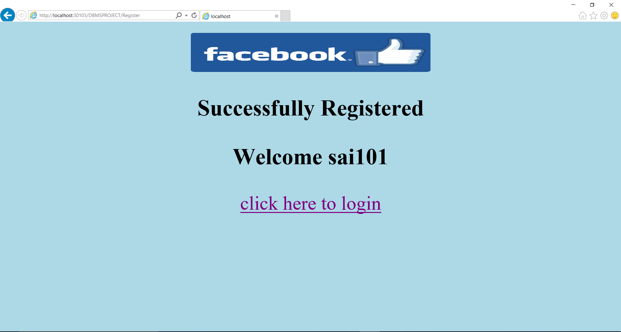
Implementation Screenshots
Successfully Registered

Slide 18
Implementation Screenshots
Login Page

Slide 19
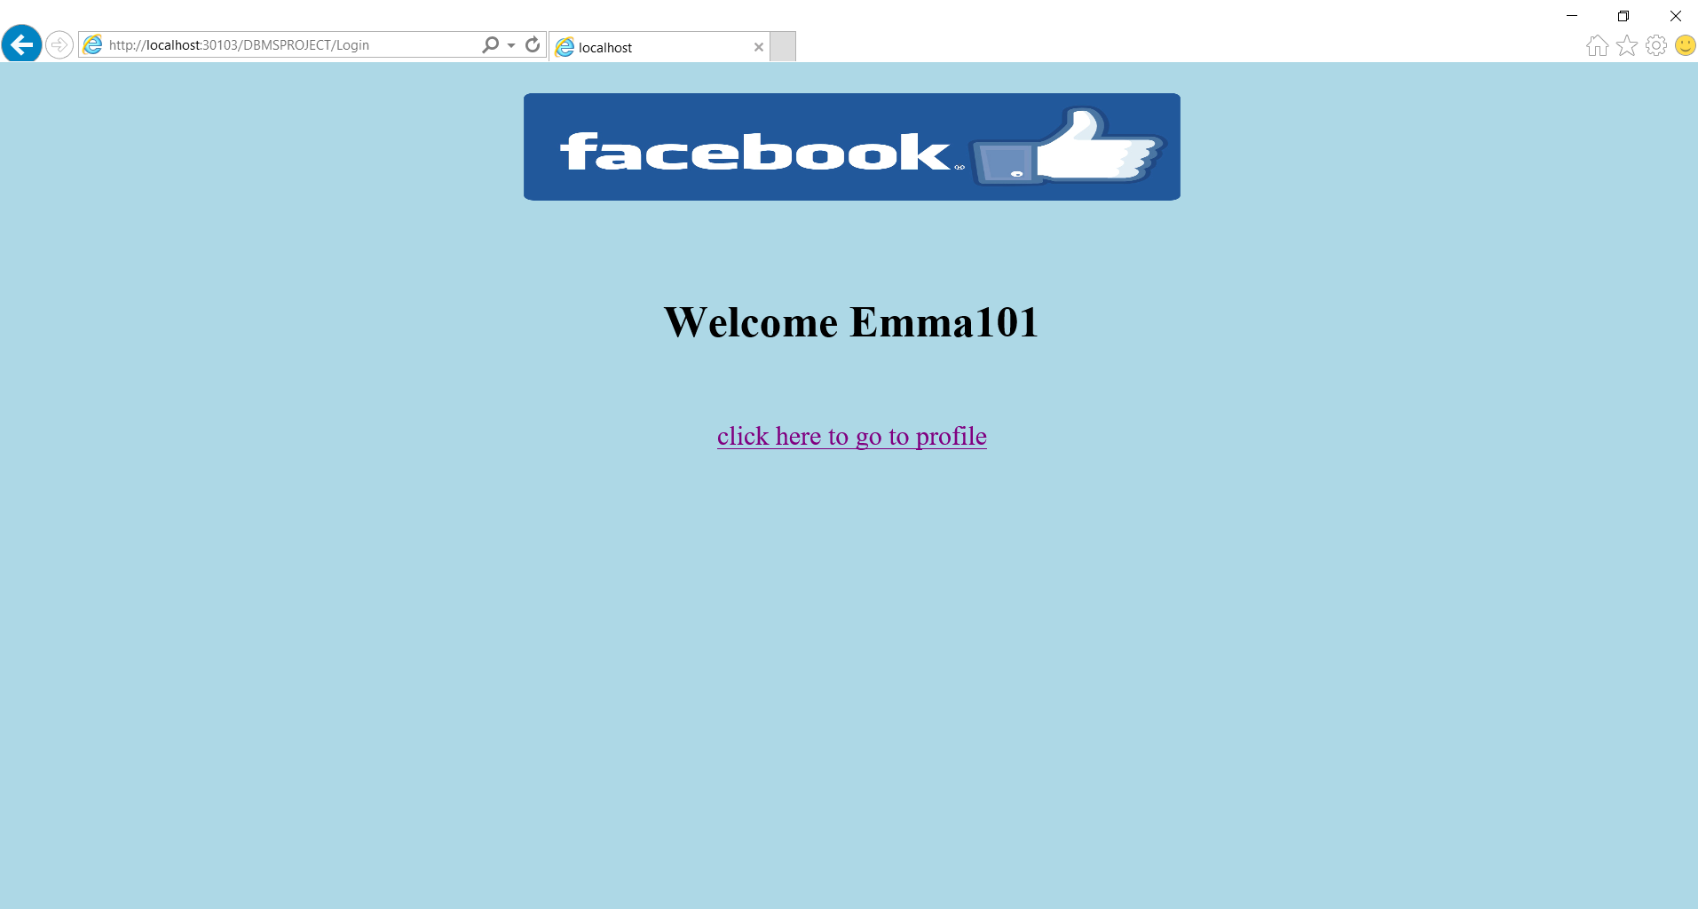
Implementation Screenshots
Welcome Page

Slide 20
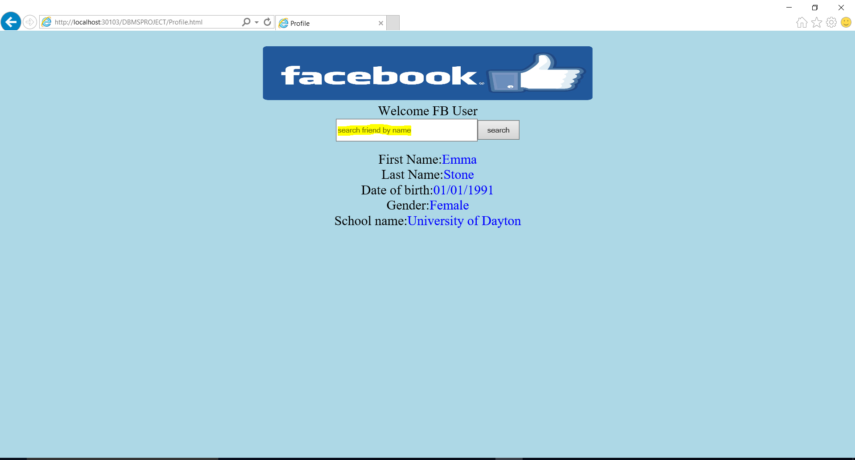
Implementation Screenshots
User Profile Page

Slide 21

Implementation Screenshots
Search Results

Slide 22
THAN ‘Q’UERIES

